Slide 1
Evaluating Character-Level Recurrent Neural Networks
Leonie Weißweiler, Daniela Gerz, Anna Korhonen
Language and Technology Lab

Slide 2
Advantages and Disadvantages of Char-Level Models
Potential advantage
the model could learn about character-level dependencies
This would hopefully capture some of the language’s morphology
The model could then generate some correct unseen words
Potential disadvantage
The generated words aren’t guaranteed to be words
There is always a chance of some of the output being gibberish

Slide 3
Motivation
Character-level models are normally evaluated with perplexity
Perplexity captures how well the model adapted to the data, not the chances and risks versus word-level models
There are little to no studies comparing different character-level RNNs

Slide 4


Analysis of Generated Text
Words that have been observed in the training data and were repeated by the model
Words that were not present in the training data, but which do exist in the language
Words that do not exist in the language
Correctness Percentage
New Sensible Word Count
$$\frac{a+b}{a+b+c}$$
$$b$$

Slide 5
Background: Language Typology

Slide 6
New Metrics
Correctness Percentage: percentage of the words in the output of the character-level model that exist in the language
→ measures how many non-words are produced
→ measures the disadvantage in comparison to word-level models
New Sensible Word Count: number of words that were not observed in the training data, but which do exist in the language
→ measures how well the model captures character-level dependencies
→ measures the advantage in comparison to word-level models

Slide 7
Evaluation Setup
Wikipedia Corpus in 38 languages
Used small chunks as training data and the rest for checking which words are in the language
Tokenized with the OpenNLP and the Polyglot Tokenizer
Tested LSTM, RNN, GRU, NAS
Standard parameters, no tuning
5 million characters training data, 500,000 characters sampled for each language

Slide 8
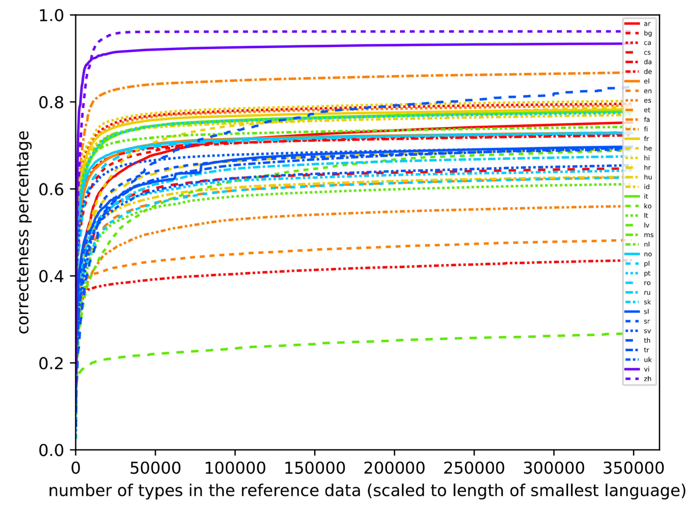
Correctness Percentages LSTM

Slide 9
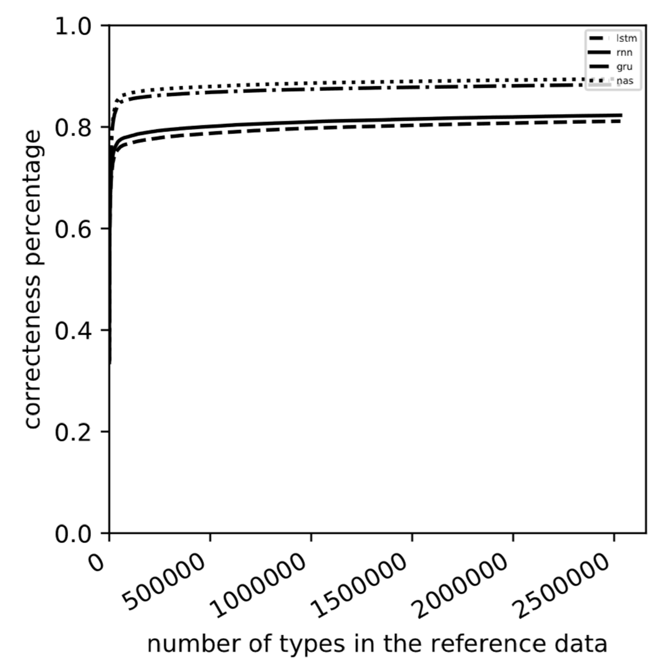
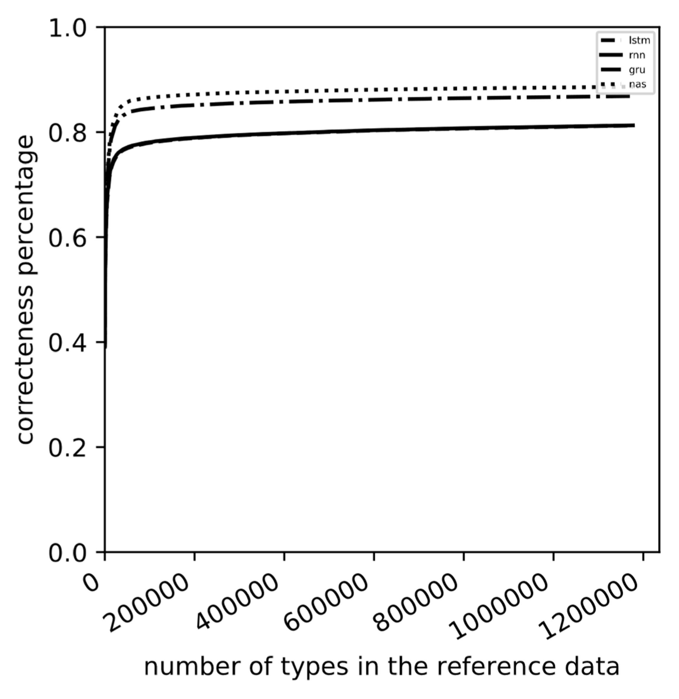
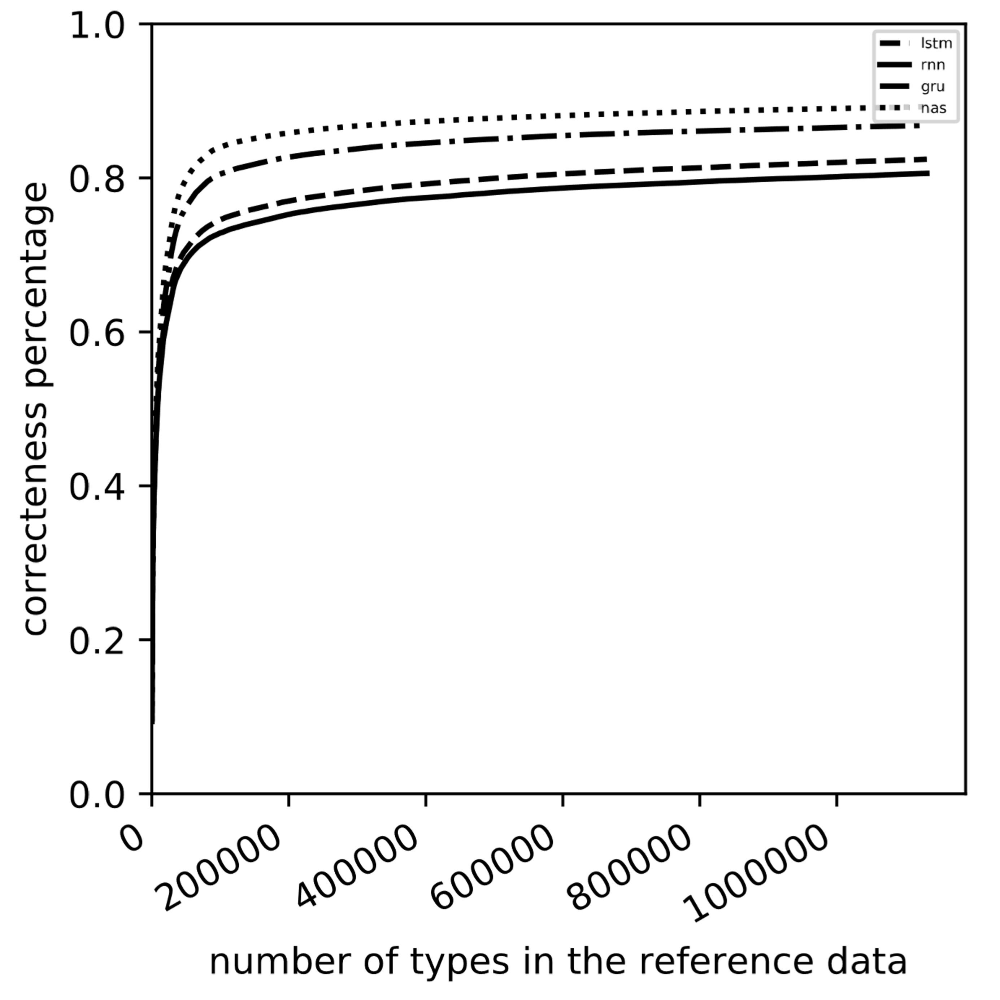
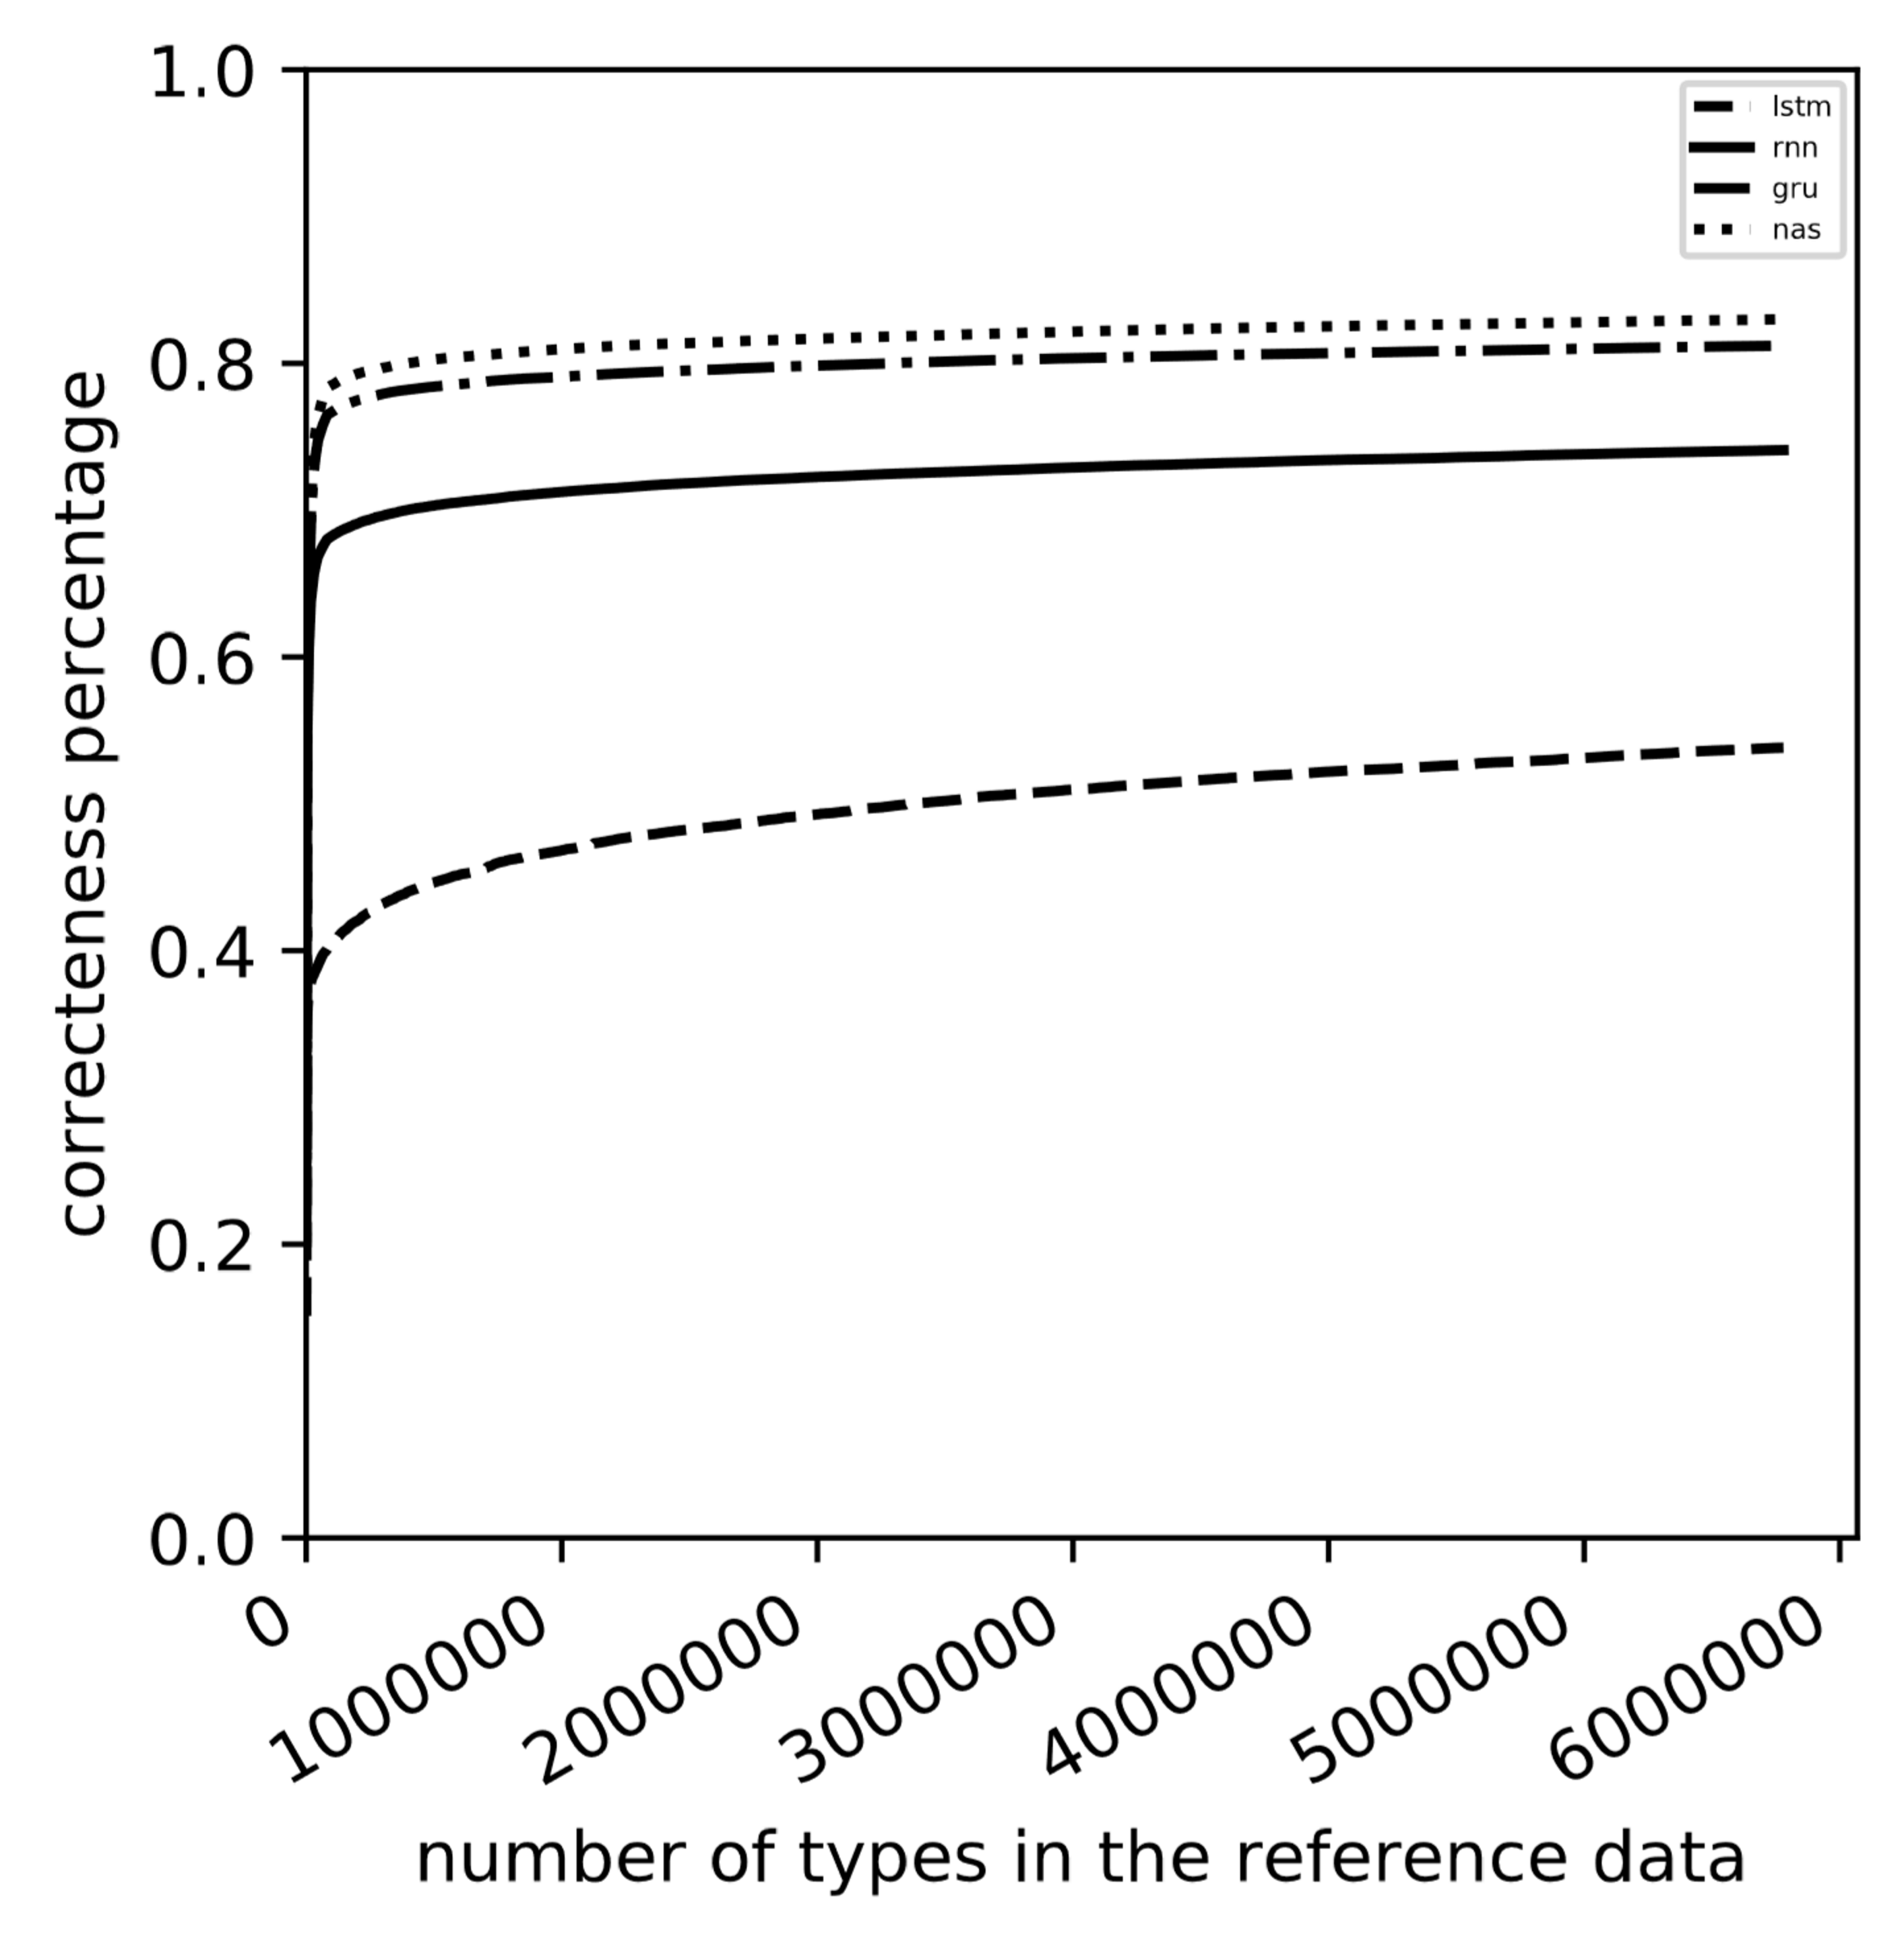
Correctness Percentage Groups
← French ← Catalan
Hebrew → German →

Slide 10
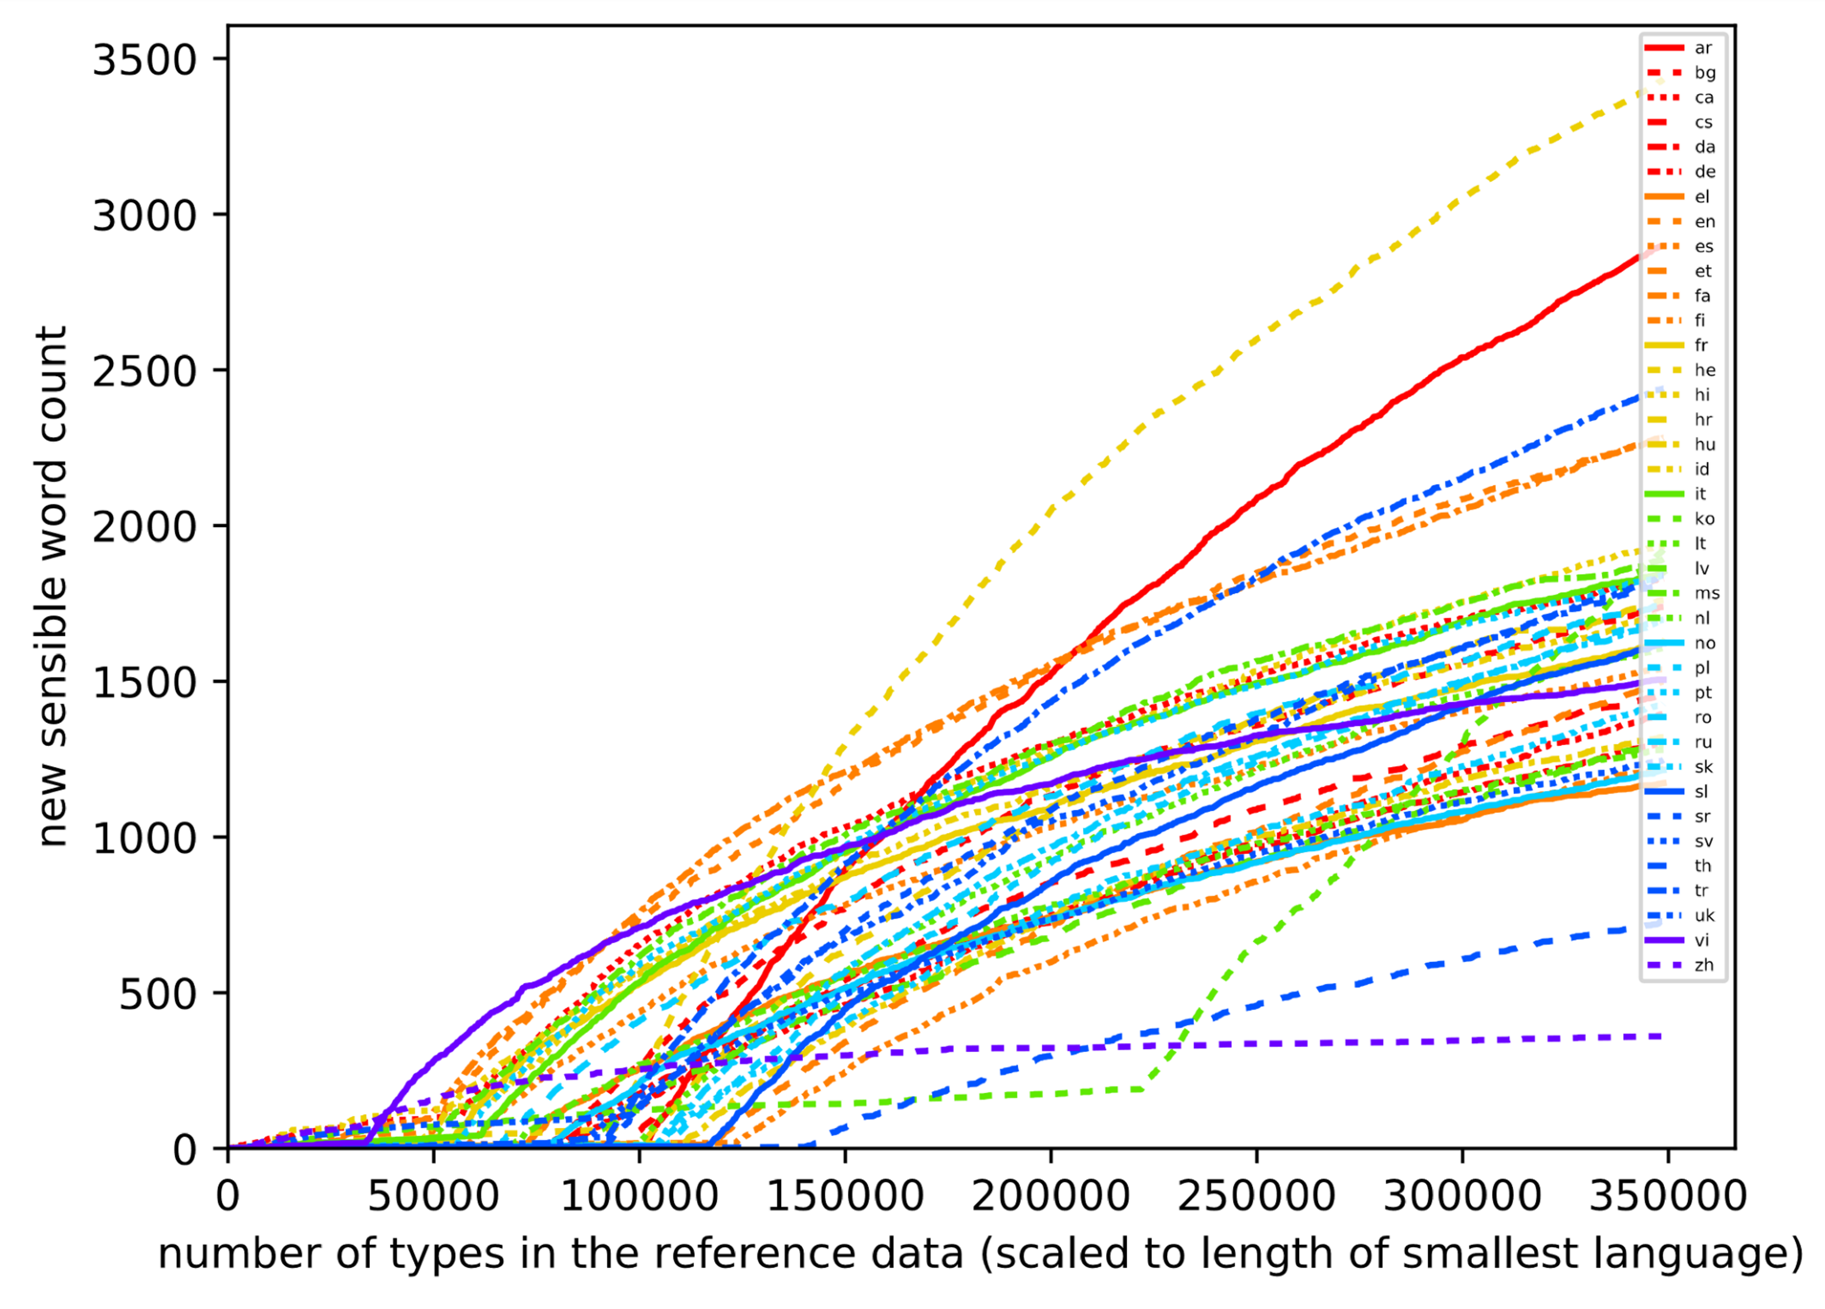
New Sensible Word Counts LSTM

Slide 11
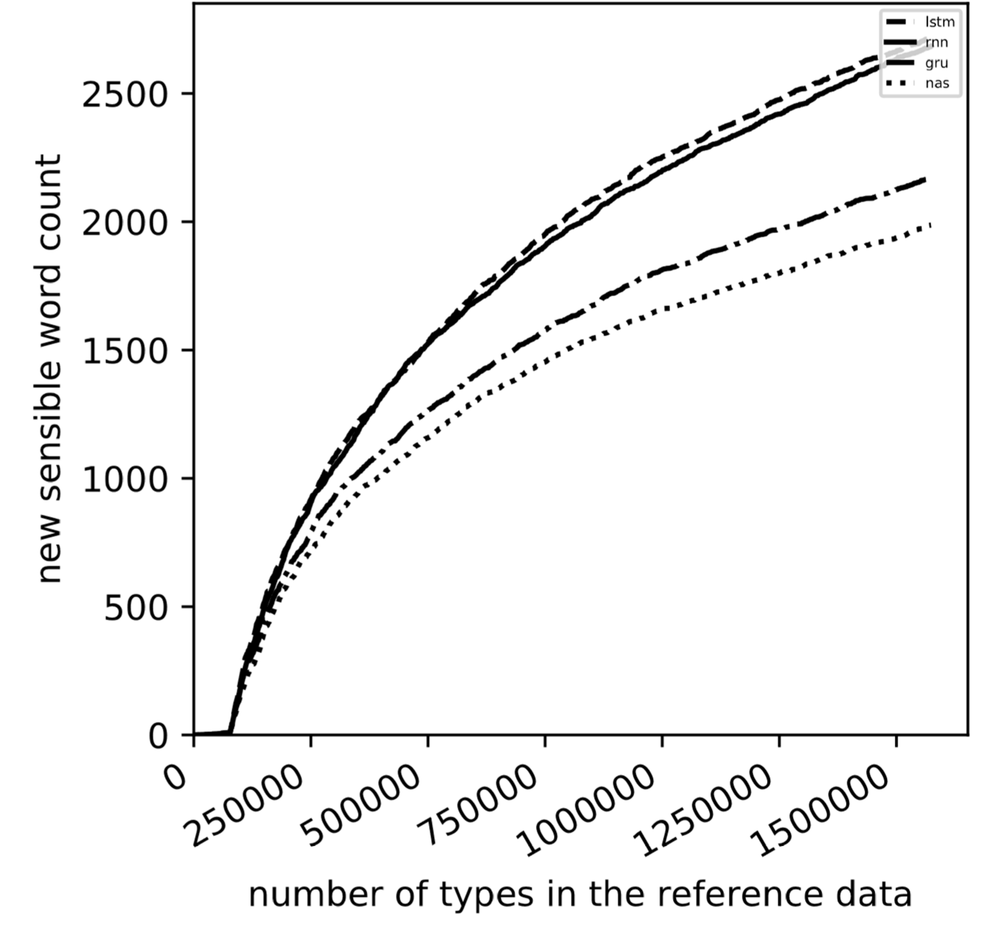
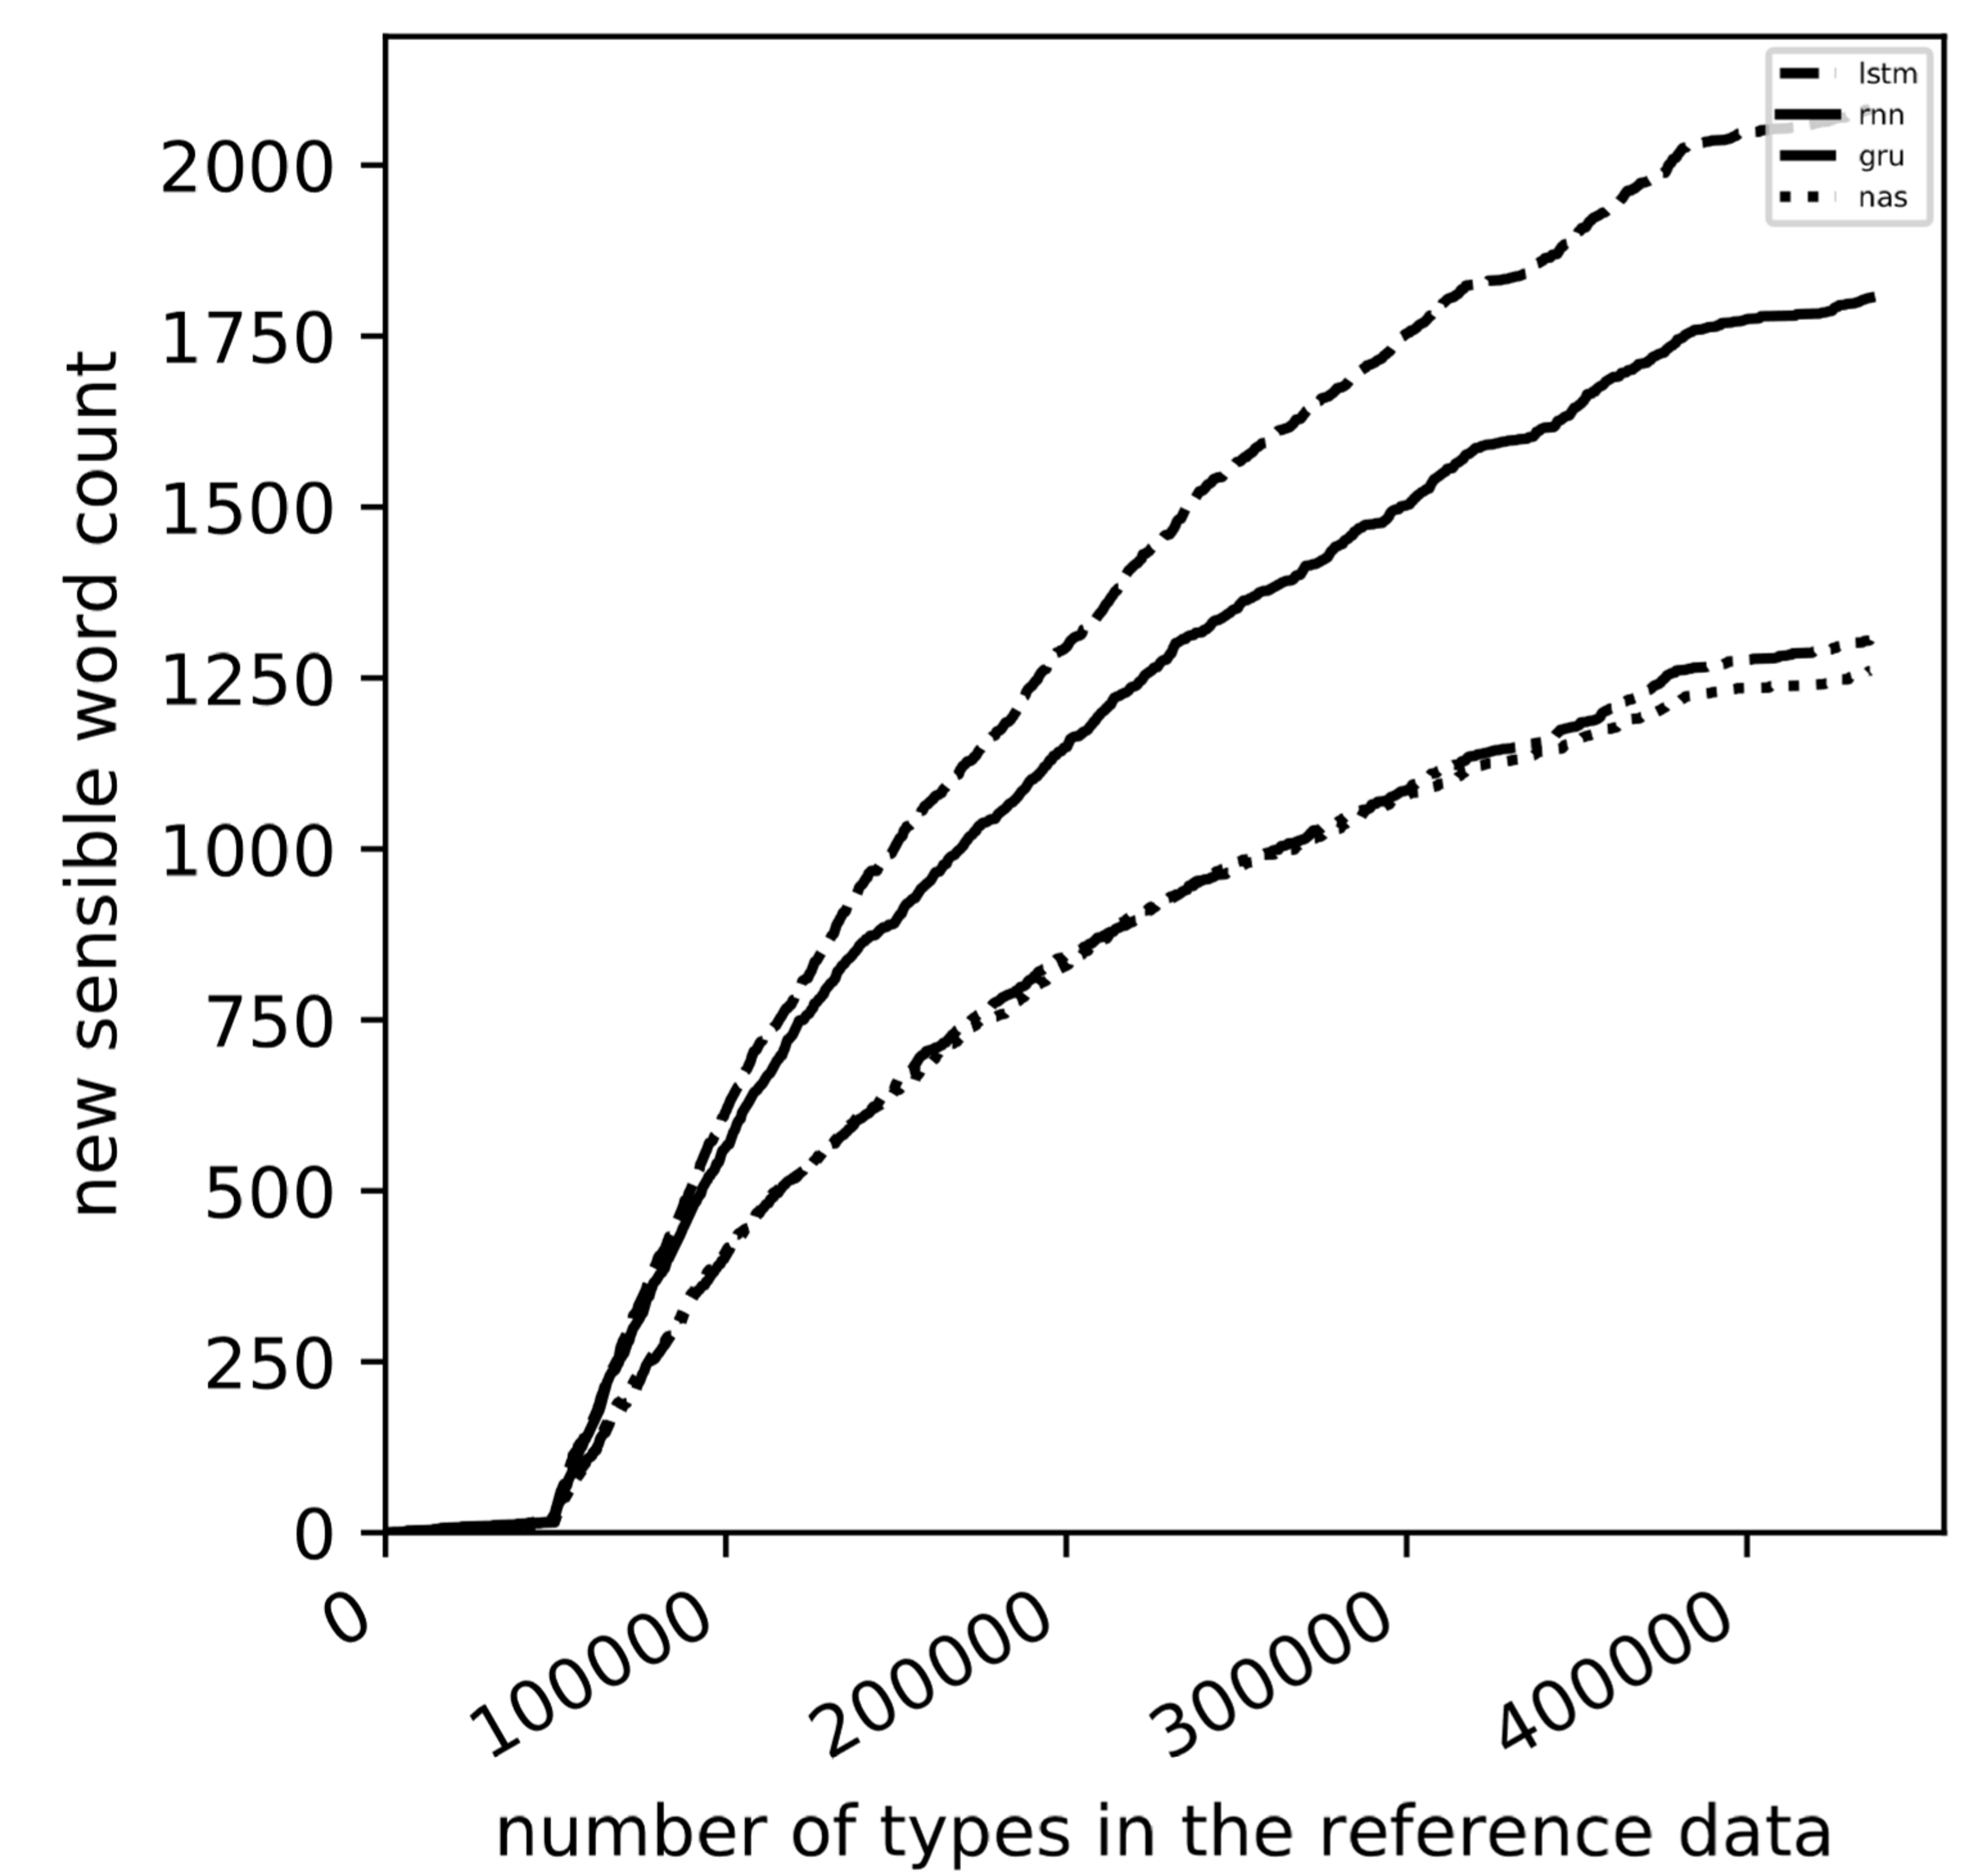
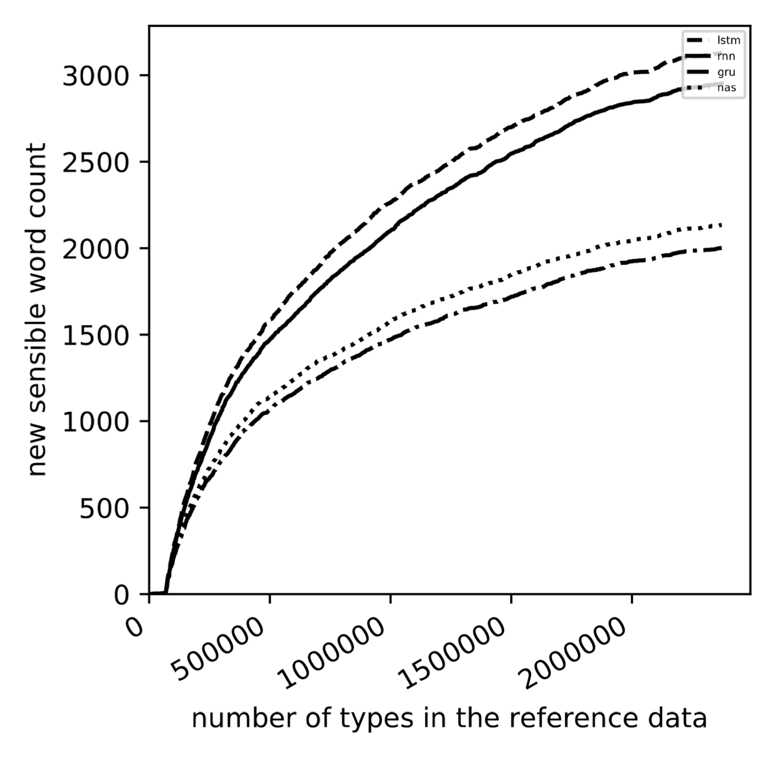
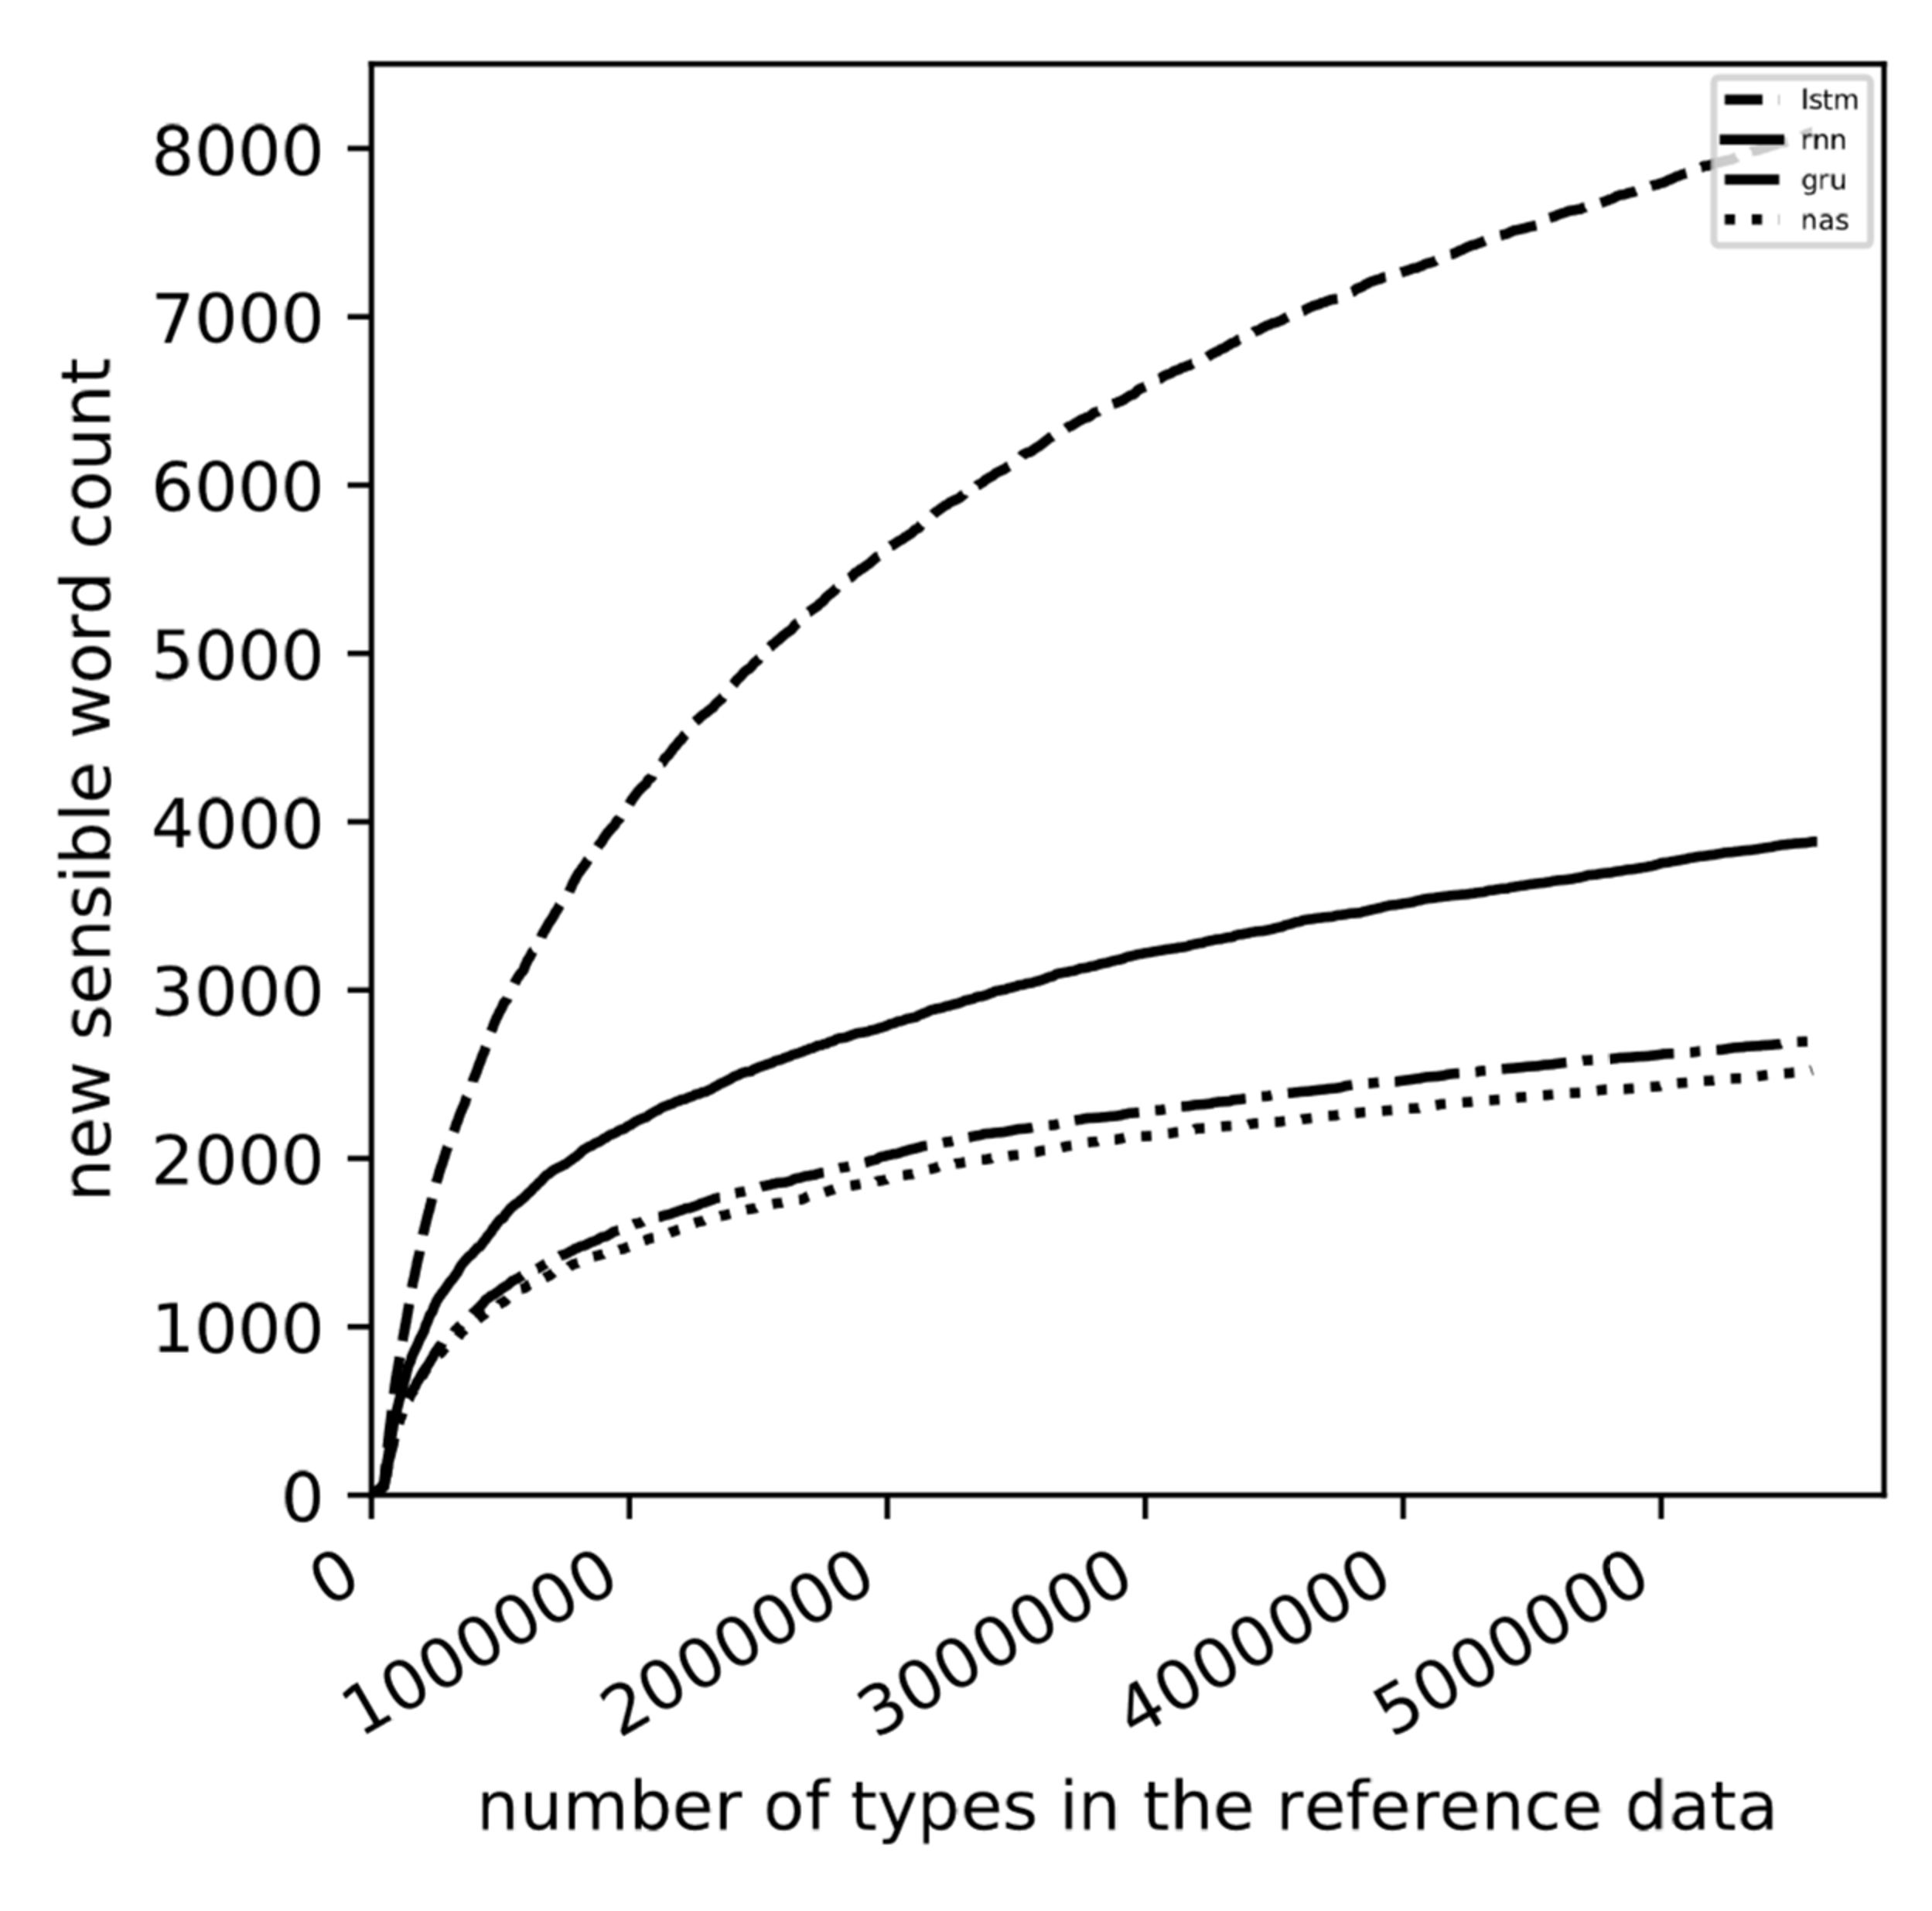
New Sensible Word Count Groups
←Norwegian ← Malay
Dutch → English →

Slide 12
General Results
General trade-off: LSTM → RNN → GRU → NAS if the Correctness Percentage is the priority, otherwise the other way around
For a number of languages, a few models, like RNN and GRU, should not be used at all
LSTM and RNN perform better for Correctness Percentage → are better at remembering words
NAS and GRU perform better for New Sensible Word Count → are better at learning patterns
Agglutinative and isolating languages perform better on average

Slide 13
Conclusion
We introduced new metrics for evaluating Char-Level RNNs that make relevant statements about their performance
We introduced the first comprehensive comparison of four Char-Level RNNs
We gave some recommendations which models are best used for which language using both new metrics

Slide 14
Current and Future Work
For publication, we are
Redoing all the experiments with a smaller, topic-controller corpus
Trying different RNN sizes, sample modes, and training data sizes
Computing perplexity scores to see if they correlate with correctness percentages

